Slide 1

WELCOME
MHRDIR 518
Strategic Management
Session-3:
Evaluating the External Environment
Professor Dr. Md. Nurul Amin
Chairman
Department of Public Administration
Jahangirnagar University

Slide 2
Evaluating the External Environment
Businesses operate within an external macro-environment that affects the likelihood of their overall success or failure.
Forces beyond the control of businesses can hinder the growth of a business or perhaps be harnessed to propel it forward.
Strategic management requires that these external and competitive forces be evaluated, so that opportunities may be leveraged and threats may be mitigated as strategies are developed to improve the success of the firm

Slide 3
Evaluating the External Environment
Three tools that help firms assess different perspectives of their competitive environment :
The PESTEL framework (Political, Economic, Socio-cultural, Environmental/Ecological, and Legal) evaluates the macro-environment through the evaluation of six external forces;
The competitive environment of the industry also must be evaluated through Porter’s Five Forces tool.
Finally, Strategic Group Mapping helps executives understand how their firm relates to other competitors in the market, and which are their most direct competitors.
Once this external analysis is complete, a firm can determine the true strategic issue(s) it faces and can develop strategies to move the firm forward toward accomplishing its vision.

Slide 4

What Is the Environment?
For any organization, the environment consists of the set of external conditions and forces that have the potential to influence the organization. In the case of ABC Bread, for example, the environment contains its customers, its rivals such as Chipotle and Starbucks, social trends such as the shift in society toward healthier eating, political entities such as the Parliament, and many additional conditions and forces.

Slide 5
Why Does the Environment Matter?
First, the environment provides resources that an organization needs in order to create goods and services.
Second, the environment is a source of opportunities
and threats for an organization.
Third, the environment shapes the various strategic decisions that executives make as they attempt to lead their organizations to success.

Slide 6
(i) Evaluating the General Environment : PESTEL Analysis
PESTEL analysis is one important tool that executives can rely on to organize factors within the general environment and to identify how these factors influence industries and the firms within them.
PESTEL is an acronym, meaning it is an abbreviation formed from the initial letters of other words. PESTEL reflects the names of the six segments of the general environment: (1) political, (2) economic, (3) socio-cultural, (4) technological, (5) environmental, and (6) legal.
Wise executives carefully examine each of these six segments to identify major opportunities and threats and then adjust their firms’ strategies accordingly.

Slide 7
Understanding PESTEL Framework
P: Political factors include elements such as tax policies, changes in trade restrictions and tariffs, and the stability of governments.
E: Economic factors include elements such as interest rates, inflation rates, gross domestic product, unemployment rates, levels of disposable income, and the general growth or decline of the economy.
S: Socio-cultural factors include trends in demographics such as population size, age, and ethnic mix, as well as cultural trends such as attitudes toward obesity and consumer activism.

Slide 8

T :Technological factors include, for example, changes in the rate of new product development, increases in automation, and advancements in service industry delivery.
E: Environmental factors, also called ecological factors, include, for example, natural disasters, global warming, pollution, and weather patterns.
L: Legal factors include laws involving issues such as employment, health and safety, discrimination, and antitrust.

Slide 9
(ii) Evaluating the Industry: Porter’s Five Forces Analysis
Understanding the dynamics that shape how much profit potential exists within an industry is key to knowing how likely a particular firm is to succeed within the industry.
There are five key forces that determine the profitability of a particular industry. Taken together, all five forces indicate the attractiveness of an industry.
Attractive industries—those with favorable conditions—are more likely to experience higher profitability.

Slide 10
Industry Analysis: Porter’s Five Forces: Introduced more than thirty
years ago by Professor Michael Porter of the Harvard Business School, Five Forces Analysis has long been and remains perhaps the most popular analytical tool in the business world
(1) Threat of potential entrants are firms that are not currently considered viable competitors in the industry but that may
become viable competitors in the future. For example, Tesla Motors’ production of electric vehicles poses a threat to displace the traditional powers in the auto industry, and Chinese automakers are rumored to be eyeing the US market.
(2) Bargaining power of suppliers to the auto industry include firms such as Lear Corporation who produces auto interior systems.

Slide 11
Industry Analysis: Porter’s Five Forces
(3) Rivalry of industry competitors in the auto industry include firms such as Ford, Fiat Chrysler, and GM.
(4) Bargaining power of buyers are those firms that buy directly from the industry such as automobile dealerships. Automakers also have to pay careful attention to end users, of course, such as individual drivers and rental car agencies.
(5) Threat of substitutes for the auto industry’s products include bicycles and mass transit. Luckily for automakers competing in the US market, Americans are notoriously reluctant to embrace these substitutes

Slide 12
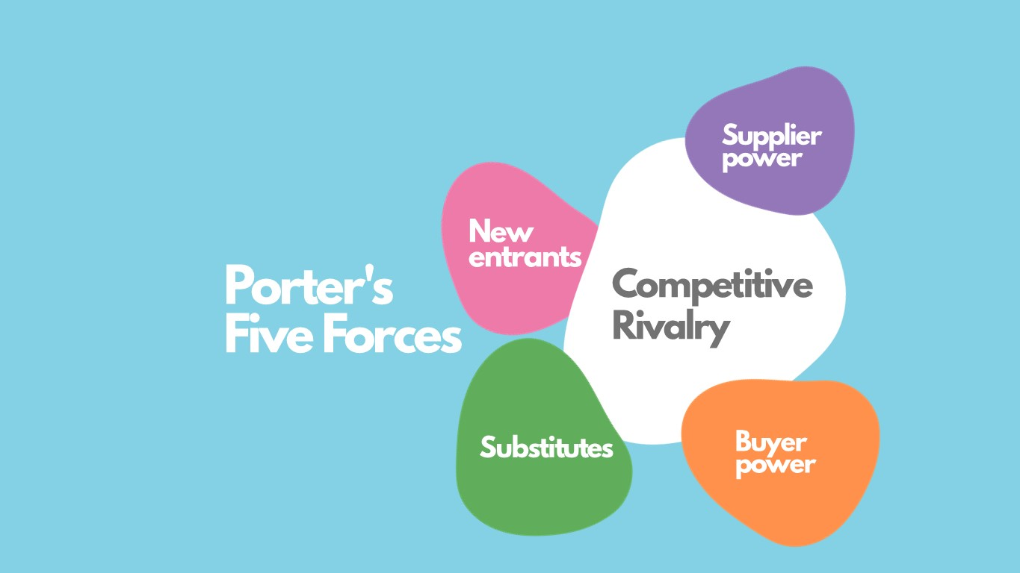
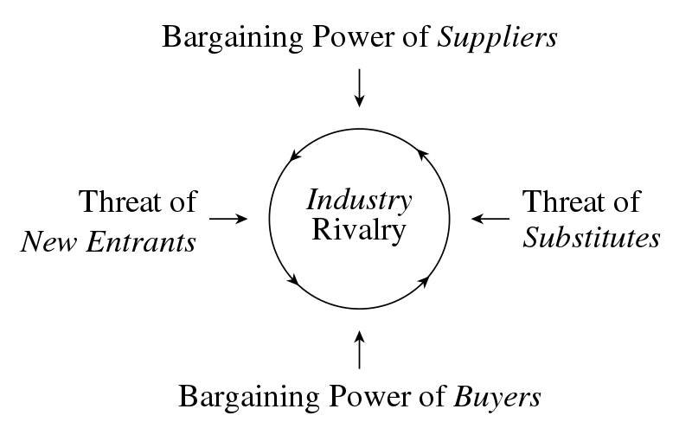
Industry Analysis: Porter’s Five Forces

Slide 13
(iii) Mapping Strategic Groups
The analysis of the strategic groups in an industry can offer important insights to executives. Strategic groups are sets of firms that follow similar strategies to one another.
More specifically, a strategic group consists of a set of industry competitors that have similar characteristics to one another but differ in important ways from the members of other groups

Slide 14
Understanding Strategic Groups
Understanding the nature of strategic groups within an industry is important for at least three reasons.
First, emphasizing the members of a firm’s group is helpful because these firms are usually its closest rivals. When assessing their firm’s performance and considering strategic moves, the other members of a group are often the best referents for executives to consider.
Second, the strategies pursued by firms within other strategic groups highlight alternative paths to success. A firm may be able to borrow an idea from another strategic group and use this idea to improve its situation.

Slide 15
Understanding Strategic Groups
Third, the analysis of strategic groups can reveal gaps in the industry that represent untapped opportunities. Within the restaurant business, for example, it appears that no national chain offers both very high quality meals and a very diverse menu. Perhaps the firm that comes the closest to filling this niche is the Cheesecake Factory, a chain of approximately 150 outlets whose menu includes more than 200 lunch, dinner, and dessert items. Ruth’s Chris Steak House already offers very high quality food; its executives could consider moving the firm toward offering a very diverse menu as well.

Slide 16
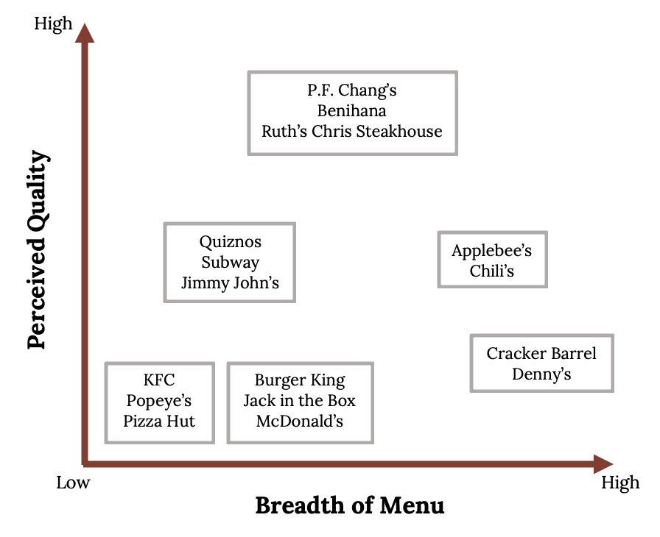
Mapping Strategic Groups in Practice
Note: To develop a strategic group map for an industry, the competitive factors for each of the two axes must be selected. On the vertical axis, price is often the measurement used. A different parameter that further differentiates the members of the industry is chosen for the horizontal axis. For the airline industry, for example, it could be the number of routes flown. It can be the breadth of models offered by each car manufacturer in the automobile industry. The competitive factors should be chosen based on the market characteristics that are to be examined, usually the most important ones

Slide 17

Thank you

